Slide 1


AI in Daily Life: Transforming the Everyday
Artificial intelligence (AI) is no longer a concept confined to science fiction. It is rapidly becoming an integral part of our daily lives, subtly enhancing experiences and streamlining tasks. From the moment we wake up to the time we go to bed, AI algorithms are at work, making our world smarter, more efficient, and more connected. This presentation will explore the fascinating ways AI is transforming the everyday, delving into its core concepts, diverse applications, and the ethical considerations we must address as we embrace this technological revolution.
by Ranganath Donkena
Asst. Professor in Computer Science.

Slide 2
What is AI? Demystifying the Core Concepts
Natural Language Processing (NLP)
Machine Learning
Deep Learning
At its heart, AI often relies on machine learning, where systems learn from data without explicit programming. This enables them to identify patterns, make predictions, and adapt their behavior over time.
A subset of machine learning, deep learning uses multi-layered neural networks inspired by the human brain. This allows for complex pattern recognition, particularly useful in areas like image and speech processing.
NLP empowers computers to understand, interpret, and generate human language. This is crucial for voice assistants, translation tools, and sentiment analysis, bridging the gap between humans and machines.

Slide 3





AI in Your Pocket: Smartphones and Personal Assistants
Voice Assistants
Smart Photography
Siri, Google Assistant, and Alexa leverage AI for voice recognition, natural language understanding, and personalized responses, making daily tasks easier to manage.
AI enhances smartphone cameras with features like scene recognition, object detection, and computational photography, resulting in professional-quality images.
Predictive Text
Navigation Apps
AI-powered keyboards learn your writing style and predict words or phrases, speeding up communication and reducing typos.
AI optimizes routes, analyzes real-time traffic conditions, and provides accurate estimated arrival times, improving daily commutes.

Slide 4





Smarter Homes: AI-Powered Convenience and Efficiency
Climate Control
Smart thermostats learn your preferences and adjust temperatures automatically, optimizing energy consumption and comfort.
Automated Lighting
AI-enabled lighting systems adapt to natural light, occupancy, and routines, creating dynamic and energy-efficient illumination.
Enhanced Security
Smart security cameras with AI can differentiate between pets, people, and packages, reducing false alarms and improving home safety.
Robotic Assistants
AI-powered robotic vacuums and lawnmowers autonomously maintain your home, freeing up valuable time for other activities.

Slide 5





Healthcare Revolution: AI Diagnostics and Personalized Treatment
Precision Diagnostics
AI algorithms analyze vast amounts of medical imaging (X-rays, MRIs) and patient data to detect diseases earlier and with greater accuracy than human doctors.
Drug Discovery
AI accelerates the drug discovery process by identifying potential compounds, predicting their efficacy, and optimizing molecular structures, significantly reducing development time.
Personalized Treatment
Based on an individual's genetic makeup, lifestyle, and medical history, AI can recommend tailored treatment plans and predict patient responses to various therapies.
Virtual Health Assistants
AI-powered chatbots and virtual assistants provide patients with initial diagnoses, answer health-related queries, and guide them through self-care routines, improving accessibility to care.

Slide 6

Driving the Future: AI in Transportation and Autonomous Vehicles
1
Advanced Driver-Assistance Systems (ADAS)
AI powers features like adaptive cruise control, lane-keeping assist, and automatic emergency braking, enhancing safety and reducing driver fatigue in modern cars.
2
Autonomous Driving
Self-driving cars use AI for perception (interpreting sensor data), prediction (anticipating other road users), and planning (navigating routes), moving towards fully autonomous transportation.
3
Traffic Management
AI-driven systems optimize traffic flow, manage intersections, and predict congestion, leading to more efficient commutes and reduced environmental impact in urban areas.

Slide 7
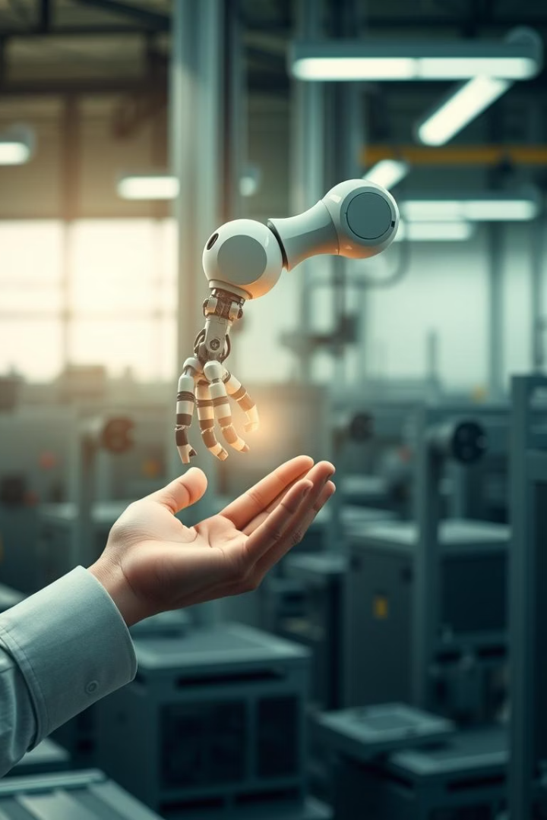
AI at Work: Automation and the Changing Job Landscape
Process Automation
Data Analysis
AI automates repetitive and data-intensive tasks across industries, from customer service chatbots to automated data entry, increasing efficiency and accuracy.
AI tools can quickly process and analyze massive datasets, providing businesses with actionable insights for strategic decision-making and market forecasting.
Job Transformation
While some jobs may be automated, AI is also creating new roles focused on AI development, maintenance, and ethical oversight, shifting the skills demanded in the workforce.

Slide 8

Entertainment Enhanced: AI in Gaming, Music, and Movies
Dynamic Gaming Experiences
AI creates more realistic non-player characters (NPCs), adapts game difficulty to player skill, and generates procedural content, leading to highly immersive and engaging games.
Personalized Content Recommendations
Streaming services use AI to analyze viewing habits and preferences, recommending movies, shows, and music tailored to individual tastes, enhancing content discovery.
Creative AI in Arts
AI assists artists in generating music compositions, movie scripts, and visual art, acting as a collaborative tool that pushes creative boundaries and explores new artistic forms.

Slide 9
Ethical Considerations: Addressing Bias and Ensuring Fairness
Bias
Privacy
Accountability
Data Bias
Data Privacy
Transparency & Accountability
AI systems can perpetuate and amplify biases present in their training data, leading to unfair or discriminatory outcomes in areas like hiring or facial recognition.
The extensive data collection required for AI raises concerns about individual privacy and how personal information is stored, processed, and protected.
The complex nature of some AI algorithms makes it challenging to understand their decision-making processes, posing questions about accountability when errors or harm occur.
Addressing these ethical challenges is crucial for the responsible development and deployment of AI. Developers, policymakers, and society as a whole must collaborate to establish robust ethical guidelines and regulatory frameworks to ensure AI serves humanity fairly and justly.

Slide 10

The Future is Now: Embracing AI for a Better Tomorrow
Artificial intelligence is not just a technological advancement; it's a societal shift that promises to redefine industries, improve quality of life, and solve some of the world's most pressing challenges. From revolutionizing healthcare and transportation to enhancing entertainment and automating mundane tasks, AI's potential is vast and largely untapped.
Embracing AI means recognizing its transformative power while also diligently addressing its ethical implications. By fostering responsible innovation, promoting transparency, and ensuring equitable access, we can harness AI to create a future that is more intelligent, efficient, and ultimately, more human. The journey has just begun, and the possibilities are limitless.

Slide 11
THANK YOU
by Ranganath Donkena
Asst. Professor in Computer Science.

